Slide 1
GCSE Mathematics
Problem Solving
Shape and Measure
Higher Tier

Slide 2
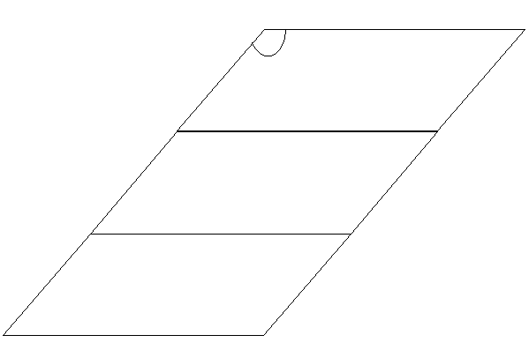


8cm
B
C
Knowing that the angle ABC = 120° calculate the area of the parallelogram BCEF.
120
3cm
A
D
3cm
3cm
F
E
8cm
Find the area of the smaller parallelogram ABCD
Do you have all the relevant measurements?
How can you find the missing measurements?
Helping Hand

Slide 3
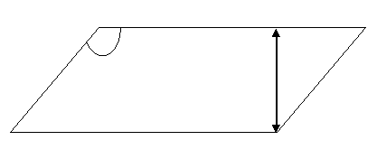
Answer
8cm
120
3cm
Area of a Parallelogram =
base x perpendicular height
The perpendicular height can be found using trigonometry.

Slide 4
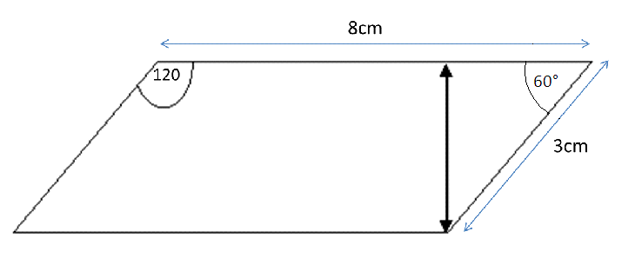
Answer
The angle BCD = 180° - 120°
= 60°
(rules for angles in parallelograms)
o
h
Sin (angle) = opposite
hypotenuse

Slide 5
8cm
Answer
B
C
120
3cm
A
D
3cm
3cm
F
E
8cm
Area of small Parallelogram = base x perpendicular height
= 8 x 2.6
= 20.8cm²
Area of large Parallelogram = 3 x small parallelogram
= 3 x 20.8
= 62.4cm²

